Slide 1
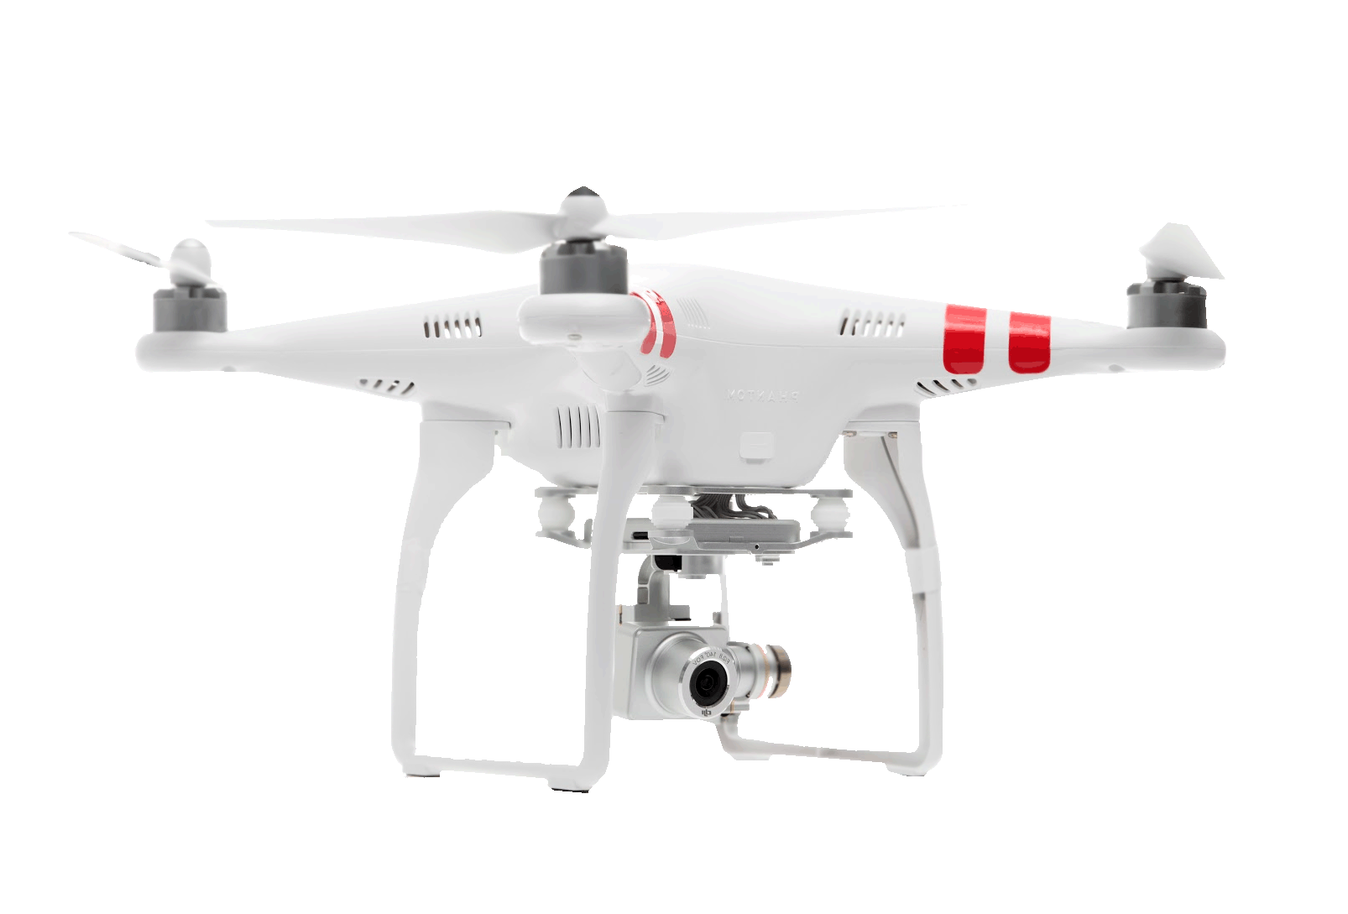
Remote Sensing Archaeological Sites through Unmanned Aerial vehicle (U.A.V.)Imaging
Presented By:
Khaliq Satchell
Cornelius Holness
Tatyana Matthews

Slide 2
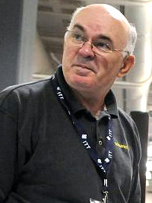
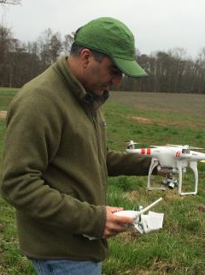
Mentors
Dr. Malcolm LeCompte
Mr. E. Clay Swindell

Slide 3
Abstract
Advances in technology and lowering cost make drones, or Unmanned Aerial Vehicles (U.A.V.), appealing platforms for remote sensing. Data acquired through these technologies have broad appeal and widespread application across many industries and disciplines. Archaeologists have used aerial imagery derived from many sources as a means of identifying sites and ancient landscapes, yet this imagery has traditionally been acquired through satellite and aircraft platforms making cost and time a primary concern. For this reason, the availability of inexpensive U.A.V.s affords archaeologists access to obtaining their own data at a fraction of the cost. However, are they effective? For the purposes of this study, the DJI Phantom 2 Vision+ UAV, along with supporting software, was evaluated for its ability to create visible light imagery and elevation datasets useful in remote sensing archaeological sites. To test its effectiveness, a site was chosen in Bertie County, North Carolina discovered in 2007. The Salmon Creek site (31BR264), as it is known, is partially understood from previous archaeological studies as the location of a 16th Century Native American village. This previous work provided a foundation which our results could be tested and evaluated against and proved important to our interpretation of the data. The project not only demonstrated the effectiveness of the U.A.V. to acquire usable datasets, but contributed to the ongoing research.
Keywords—archaeology, aerial imagery, DJI Phantom 2 Vision+, drone, remote sensing, U.A.V.

Slide 4
Objectives
primary objective of this research was to develop a working methodology for CERSER’s use of U.A.V.s for future remote sensing and archeological purposes.
A secondary objective for the project was to produce new data sets archaeologists could use in future studies.

Slide 5
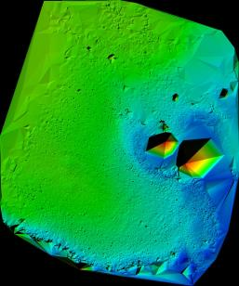
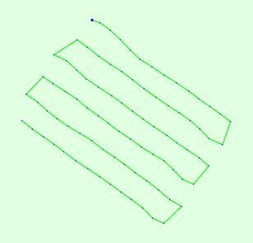
Methodology

Slide 6
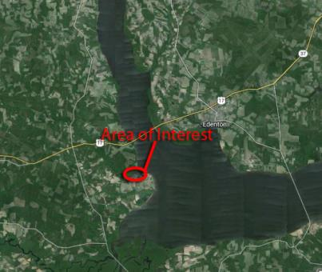
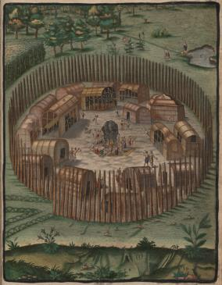
Area of Interest
Salmon Creek site is Located at the western end of the albemarle sound near the Confluence of the chowan & Roanoake Rivers.
Archaeologists think it is the location of the Indian village MetaCuuem.
The village of MetaCuuem looked similar to the village of Pomeioc painted in the 16th century by English Artist John White.

Slide 7
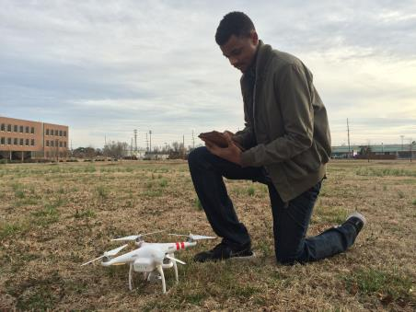
Equipment
DJI Phantom 2 Vision + Key Features
Inexpensive
a built-in Naza-M V2 Flight Control System for Autonomous flight
integrated gimbal and 14 mp camera
Internal GPS and barometric Altimeter
Flight Time is approximately 25 minutes

Slide 8
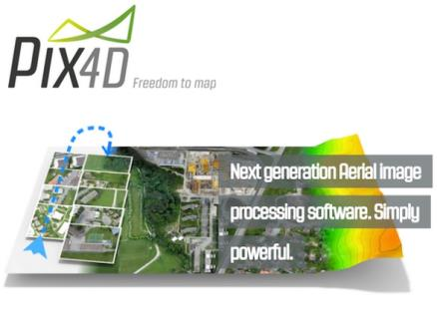
Equipment
Software Features
Ability to Stack images to create large Photo Mosaics
Can process Multispectral Images
Build 3d Point Cloud from 2d Imagery
Costly but Alternative Pricing such as Educational Licesnce
Mobile Application to Plan Flights

Slide 9
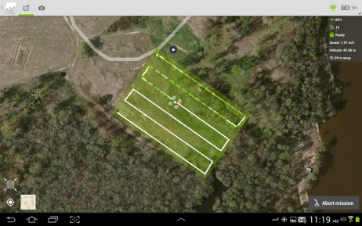
Developing A flight Plan
Key considerations
Establish Survey area within AOI
Make sure linear transects are properly aligned with survey area
Take off location is in clear unobstructed location
Make sure no obstacles are in mission area
Weather conditions
Pilot must always be ready to take control of U.A.V

Slide 10
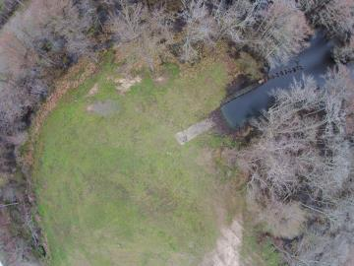
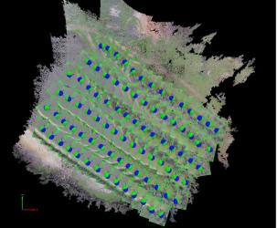
Image Processing
Goal to Create Photo Mosaic From Individual Images
87 Individual images collected
Geo-referenced images Processed with Pix4d Mapper Pro into Mosaic
Pix4d finds overlap in images and looks for commonalities to build the larger mosaic
3d Point Cloud created from 2d Imagery

Slide 11
Image Processing

Slide 12
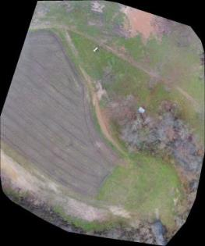
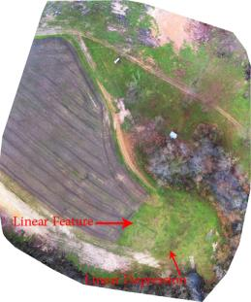
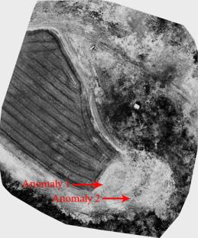
Analysis and Results
Visible Color
Contrast Enhanced
Faked IR
Processing yielded a visible color mosaic image which we manipulated to emphasize Features and Anomalies
We Identified Three Features during our analysis

Slide 13
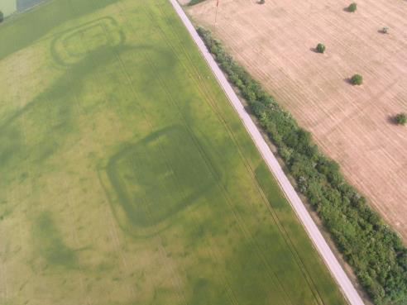
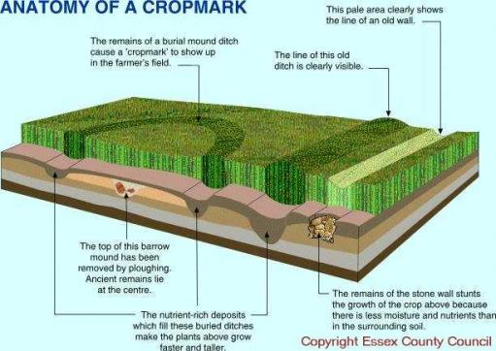
CropMarks
Crop marks are formed by variations in the subsoil, which can be caused by buried archaeological features, such as bricks and other various items or structures which cause differential crop growth

Slide 14
Linear Feature
This feature seen in Fig. 11 is best described as a positive crop mark
It is linear, oriented roughly north/south
We are confident it represents one of several trenches excavated by archaeologists in 2007
demonstrates the major concept of how variations in vegetation color and type denote subsurface features

Slide 15
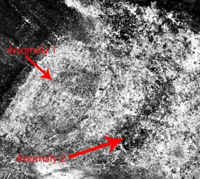
Anomaly One
large oval feature only visible in the faked IR image
Its dimensions are roughly 60 feet by 45 feet oriented east/west.
The linear feature, or the 2007 trench, cuts directly through its center which suggest It is not related to the 2007 trench
plants within the radius are sparse suggesting more compact soils inhibiting plant growth
Could represent or indicate the location of Houses or refuse area

Slide 16
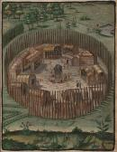
Anomaly two
Anomaly 2 is present in all images as well as 3d Point Cloud
It is linear, oriented east/west
The darker coloring of this feature suggests that it is saturated from an overly wet winter
Feel are certain it is man made
Possibly could represent a ditch associated with the Indian Village

Slide 17
Conclusion
Our primary objective for this research was Acquire, test, and develop a working methodology for CERSER’s use of U.A.V.s as a platform for future remote sensing and archeological purposes.
Our Results demonstrate that the technology is accessible and that the methodology we employed was highly successful
A secondary objective for the project was to produce new data sets archaeologists could use in future studies.
Using the available technology and our methodology, we were able to identify Anomalies we feel archaeologists should investigate further

Slide 18
Acknowledgements
The team wishes to recognize :
Clay Swindell for his guidance, contributions, and help with completing this research.
Dr. Linda Hayden for the research opportunity that was made possible through the CERSER program.
Dr. Malcolm LeCompte for supplying the DJI Phantom 2 Vision+ and his support in the project.
Michael Flannely for access to the Salmon Creek property.
Without any of these individuals this project would never have succeeded.

